Slide 1


INTELLIGENT HOSPITAL MANAGMENT
TEAM-10
BY
2010030309-K MANIDEEP REDDY 2010030457-M.ABHIRAM 2010030064-I KAUSTUBH SASTRY 2010030197-K.V.MANOHAR KARTHIK

Slide 2

TABLE OF CONTENTS
INTRODUCTION
LITERATURE SURVEY
PROBLEM STATEMENT
MODULES
TOOLS
WORK ALLOCATION
CONCLUSION

Slide 3
ABSTRACT
Technology has improved immensely in recent days. Improving the quality of one’s life is an important benefit of technology in healthcare. Besides, it also reduces the burden of staff in the hospital and improves the health of the patient easily and efficiently.
The three keys in the healthcare sector are
• Technological enablement
• Digitization
• Automation
This transformation with the Hospital Management System switches traditional hospitals into Smart Hospitals. Moreover. Smart hospitals have the potential for exponential growth.
Smart Hospitals are in high demand in the 21st century. The market value of smart hospitals accounted for 22.2 billion USD in 2018. However, in 2021, it has risen to 35.9 billion USD. Moreover, the estimated market value in 2026 is 83.1 billion USD!!! Thus, technology is essentially a catalyst in the healthcare industry. (Source: Statista)

Slide 4

INTRODUCTION
Intelligent hospital is an application which is developed to retrieve patient’s details easily. In this application doctor directly collects all the information of the patient regarding the disease like patient name, age, gender, B.P, weight blood test, urine test place and the description of the disease. Doctor can analyse the disease of the patient easily with in no time with this information. Doctor can search the symptoms and find the cure to the disease easily. Depending on the result found related to patients' symptoms doctor will prescribe medicines to the patient. When doctor finds new symptoms, he can add the related information in the database which he can analyse the same disease in future without any waste of time. Doctor can view the graph which shows the level of various disease in various locations.

Slide 5
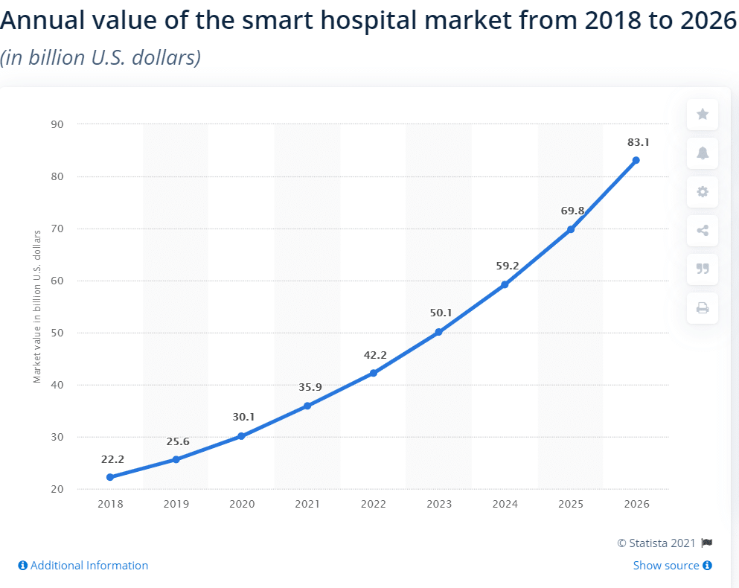
GROWTH IN SECTOR
We have analyzed that there will be tremendous growth in the health sector, that is talking in simple words the demand will rise tremendously to a stage where the current health care sector policies and services will fail. Therefore, the Intelligent hospital management system will serve as soon boon.

Slide 6

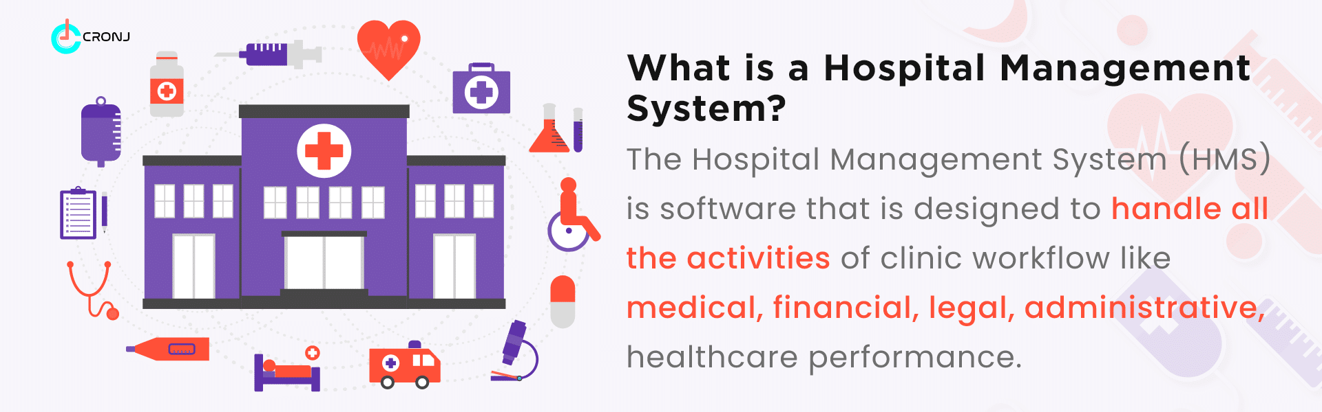
OBJECTIVE
The main objective of this Intelligent Hospital application is to save time of both patient and the doctor. To provide a quick exploration of the disease. This application provides a search option to the doctor where he can get the result very quickly by selecting the symptoms of the patient. This application provides a graph with the details of levels of the disease in various locations.

Slide 7

LITREATURE SURVEY
1. “A hospital resource and patient management system based on real-time data capture and intelligent decision making” Author(s): Musa, A. Lancashire Bus. Sch., Univ. of Central Lancashire, Preston, UK Yusuf, Y, Meckel.M. Systems and Informatics (ICSAI), 2012 International Conference
One of themajor challenges existing hospital management systems face is around operational efficiency and wait times between different processes, departments and persons. This paper highlights such limitations of existing systems and proposes a RFID(Radio Frequency ID) and wireless sensor based , location and information management framework that facilitates real time tracking of hospital assets, personnel and patients as they move through pre-set procedures as part of daily activities of the hospitals

Slide 8
LITREATURE SURVEY
2.“Study on information system of health care services management in hospital”
Author(s): Daiping Hu, Antai Sch. of Manage., Shanghai Jiaotong Univ., China Weiguo Xu ; Huizhang Shen ; Mengyu Li. Services Systems and Services Management, 2005. Proceedings of ICSSSM '05. 2005 International Conference .
This paper reviews the HIS (Hospital Information Systems) which are widely used in many hospitals in China mainly to provide easier and faster way for daily medical tasks /activities with a GUI And provides for overcoming some of the limitations of HIS , eg. HIS aims at improving quality of health care services but do not have way of evaluating /measuring those. So this paper proposes HSMS (Hospital Services Management System) which aims at improving quality of services, identifying cost reduction areas , analyses and evaluate /rate heath care services .

Slide 9
LITREATURE SURVEY
3.“Developing Effective Hospital Management Information Systems: A Technology Ecosystem Perspective”.
Authors: Dr Christopher Bain MBBS, Master Info.
The author of this paper focuses more on needs of hospital manager and the ecosystem in which he/she operates. The internal and external Environment shaping factors ESFs that bear an impact or association on daily hospital activities and decision-making process that the hospital manager has to go through in each situations. Some of the challenges that this ecosystem needs to work on are high demand pressure, greater customer satisfaction level and low profit margins. This paper more so contributes to Planning, Design and development aspects of any Hospital management system by highlighting ESFs that should be considered

Slide 10



MODULES
Doctor:
Doctor can register by entering the information. He can get login by entering the unique username and password. Doctor can add patient details, search the disease by selecting the symptoms and he can view the graph of the disease levels in various locations.
Admin Login:
The admin is holding the credentials for the website , using which we can monitor the whole activities of the website .Master access to the other modules
User/patient login:
The patient login provides the interface to interact with the doctors ask their queries and upload their documents .

Slide 11
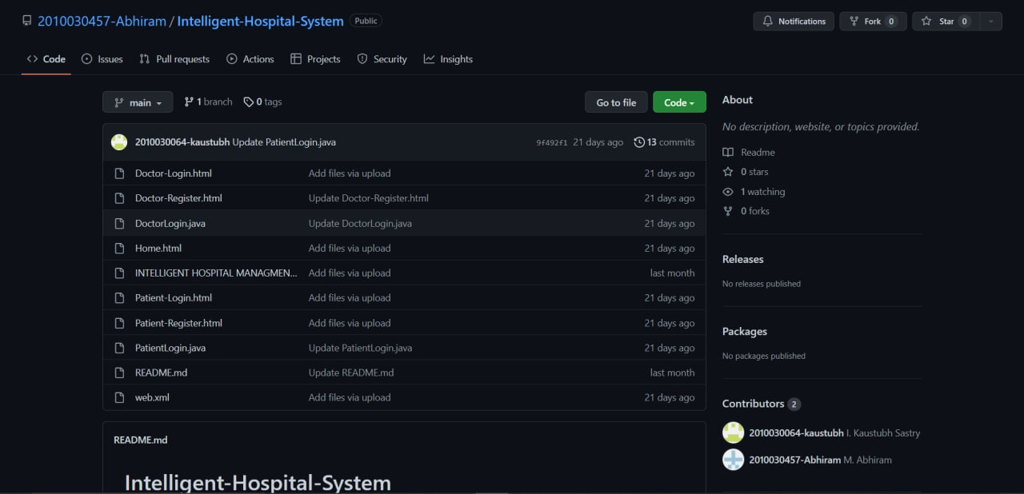

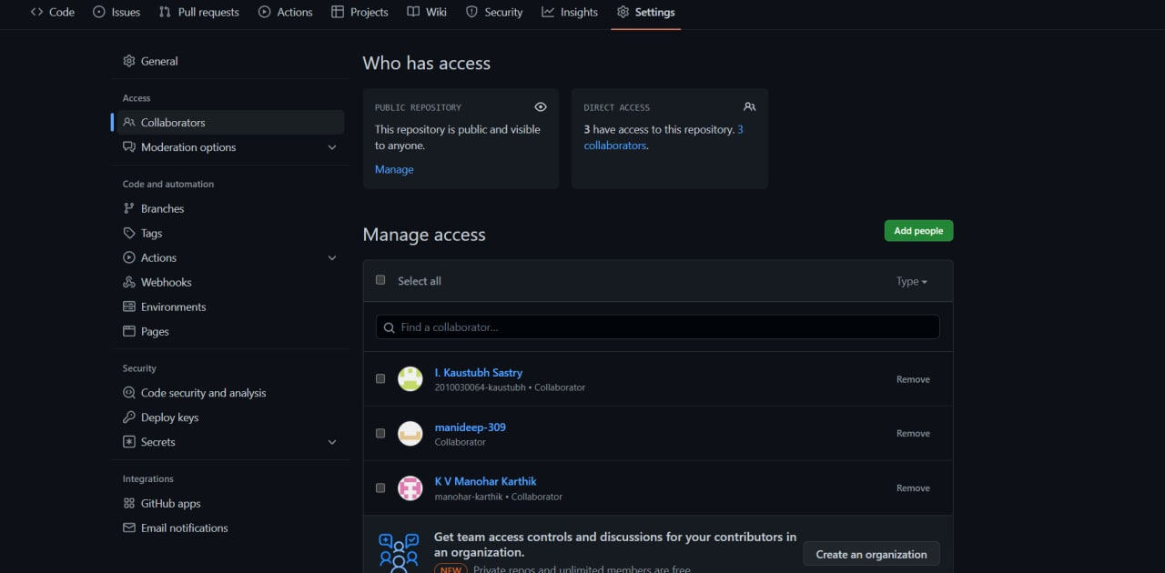
GITHUB
We have created a repository under the project heading and uploaded the project documents into it
The github repository link is 👇👇
https://github.com/2010030457-Abhiram/Intelligent-Hospital-System

Slide 12
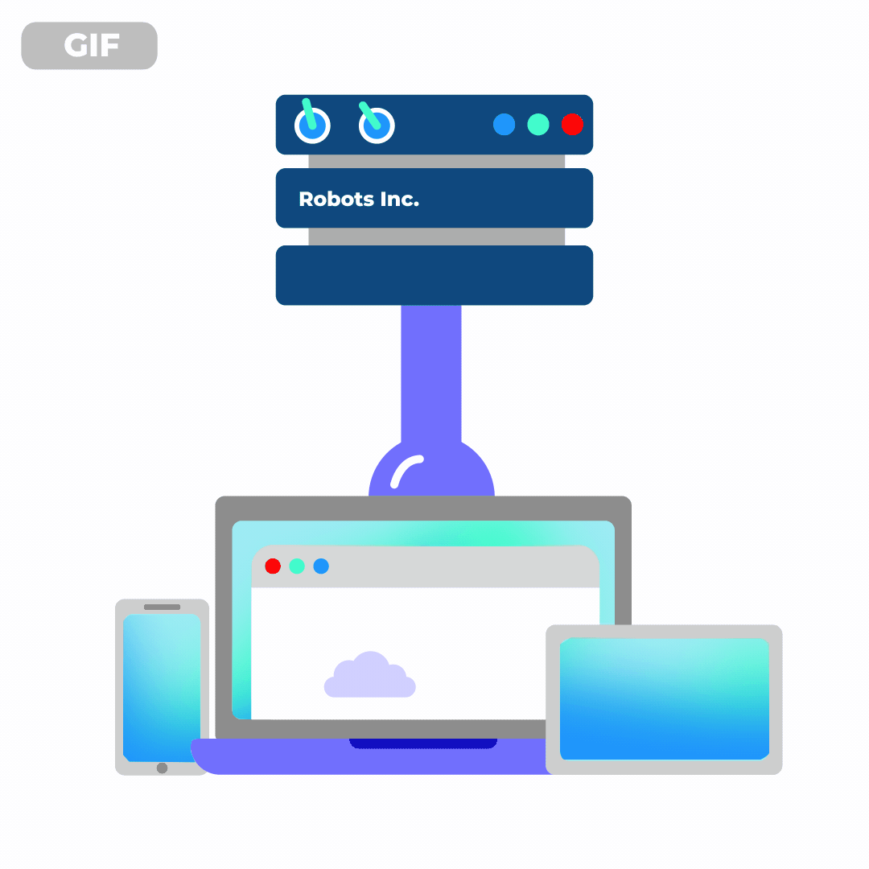
TOOLS
Operating System : windows 10,11 later
Web Server : Tomcat version 10
Database server : My SQL ,Access
Runtime Environment :Java Runtime Environment 5.0
Development tools: Eclipse,Intellji idea
Web Browser : chrome,edge,firefox,brave

Slide 13

WORK PROGRESS
We have created a website using HTML,CSS,JSP as front-end tool we have tested the working using local system server. But we encountered errors while running
We have created a Database, for the attribute's we are trying to include in the project, we have to establish live connections to the website and Database, unfortunately we encountered errors while doing the same
We are still working on the connectivity issues .

Slide 14
FUTURE SCOPE & DEVLOPMENTS INTENDED
We are working on enhancing the work we completed by adding numerous modules to the work, we are trying to build a whole new virtual hospital system. We are planning on adding the following modules to it:
Lab Management:
Handle your orders, automate report generations, enable smart notifications. Further, switch to analytical reports with an online Hospital management system.
Improve Customer Services:
Customer service is meeting the needs and requirements of the customer. The ultimate goal of hospital management software is to provide accurate and complete information or data at once. Thus, HMS increases customer support services.
OT Management:
Check the OT availability with the online Hospital management system. Thus, automate operation scheduling and make use of Operation theatres efficiently.

Slide 15
CONCLUSION
Our application “Intelligent Hospital” maintains all the patient’s information and the disease details securely. Using this application patient details can be retrieved easily. This application guarantees the accurate maintenance of the patient details and gives the cure to the symptoms of the patient in very less time. Doctor can find the treatment to the symptoms of the patient by clicking on the search button which saves lot of time. This application also provides graph for various diseases in various locations.
Advantages of this system:
1. Digital medical records reduce the errors and records each data in detail
2. Provides easy access to patient history
3. Improves efficiency of the staff
4. Manages hospital facilities efficiently
5. The use of technology reduces the time-consumption
6. Hospital management software is cost-effective and helps in tax planning
7. Hospital management system software improves market strategies and provides better financial control
8. Enhanced patient care
The main advantage of this hospital information management system is it eliminates the risk of “lost files”. However, it provides access only to authorized users. Thus, the hospital information management system ensures high security.
On the other hand, a hospital information management system reduces labor and seamlessly manages patient data. This data can be accessed across healthcare firms, beyond physical borders.

Slide 16

FUTURE SCOPE
We are planning on going ahead with the idea and developing it in the industrial scale ,an application which could prove to be a breakthrough in the medical and service sector
“AMBI-G0”

Slide 17
THANK YOU

